Slide 1
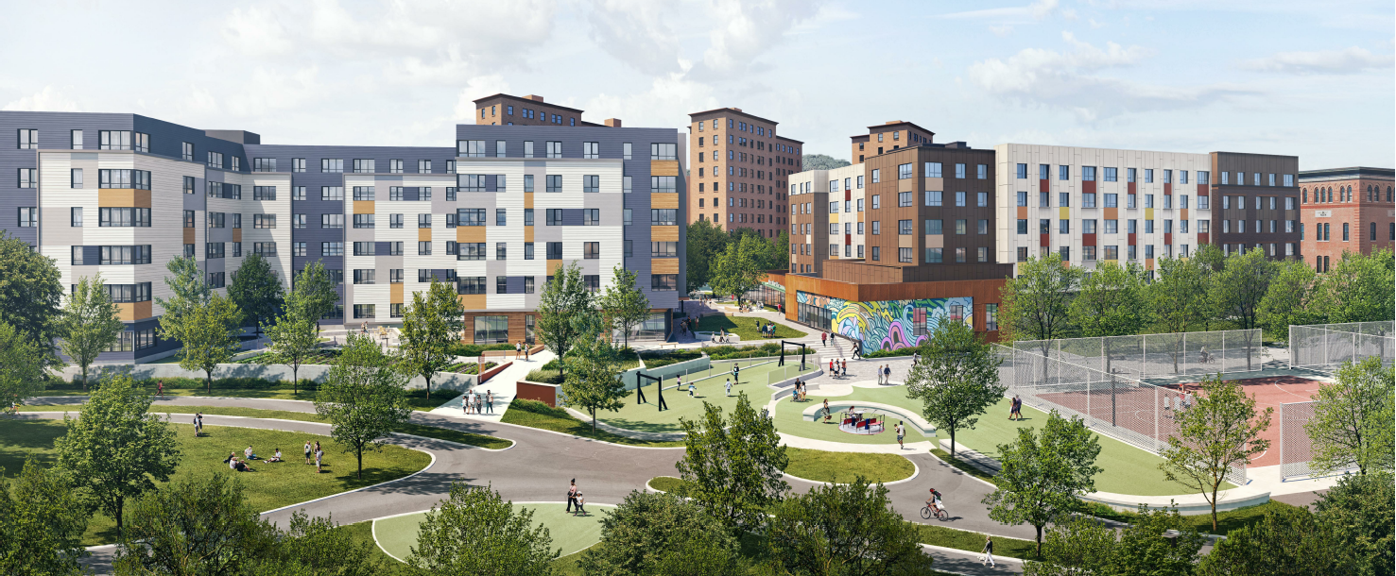



Mildred C. Hailey Phase 2 Relocation
Meeting
Notes:
BHA- Amy

Slide 2
Introductions
Boston Housing Authority (BHA)
Real Estate Development, Amy Tran
Operations Department, Maria Bonilla and Neyda Gomez
Judy Cohn Housing and Relocation Consultants (JCHRC)
Judy Cohn
Kyrah Rodriguez 617-445-2225 ext 1
Jason Martins
Cynthia Murchison
The Centre Street Partners
Laura Martin and Keveisha Robinson-Clark (The Community Builders)
Ricky Guerra (Jamaica Plain Neighborhood Development Corporation)
Urban Edge
TCB Management
Betsy Johnson
Mildred C. Hailey Task Force
Notes:
Amy

Slide 3
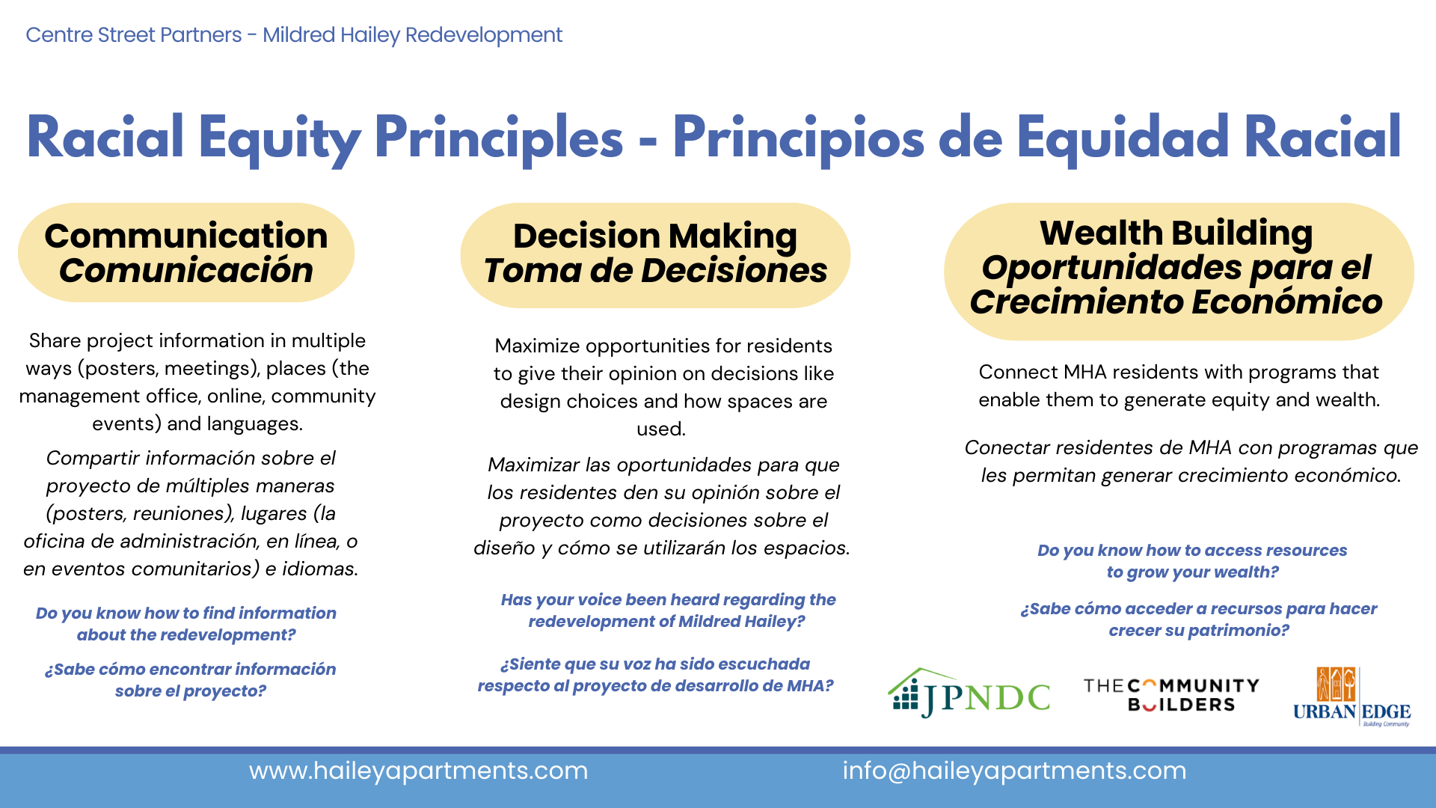
Notes:
CSP

Slide 4
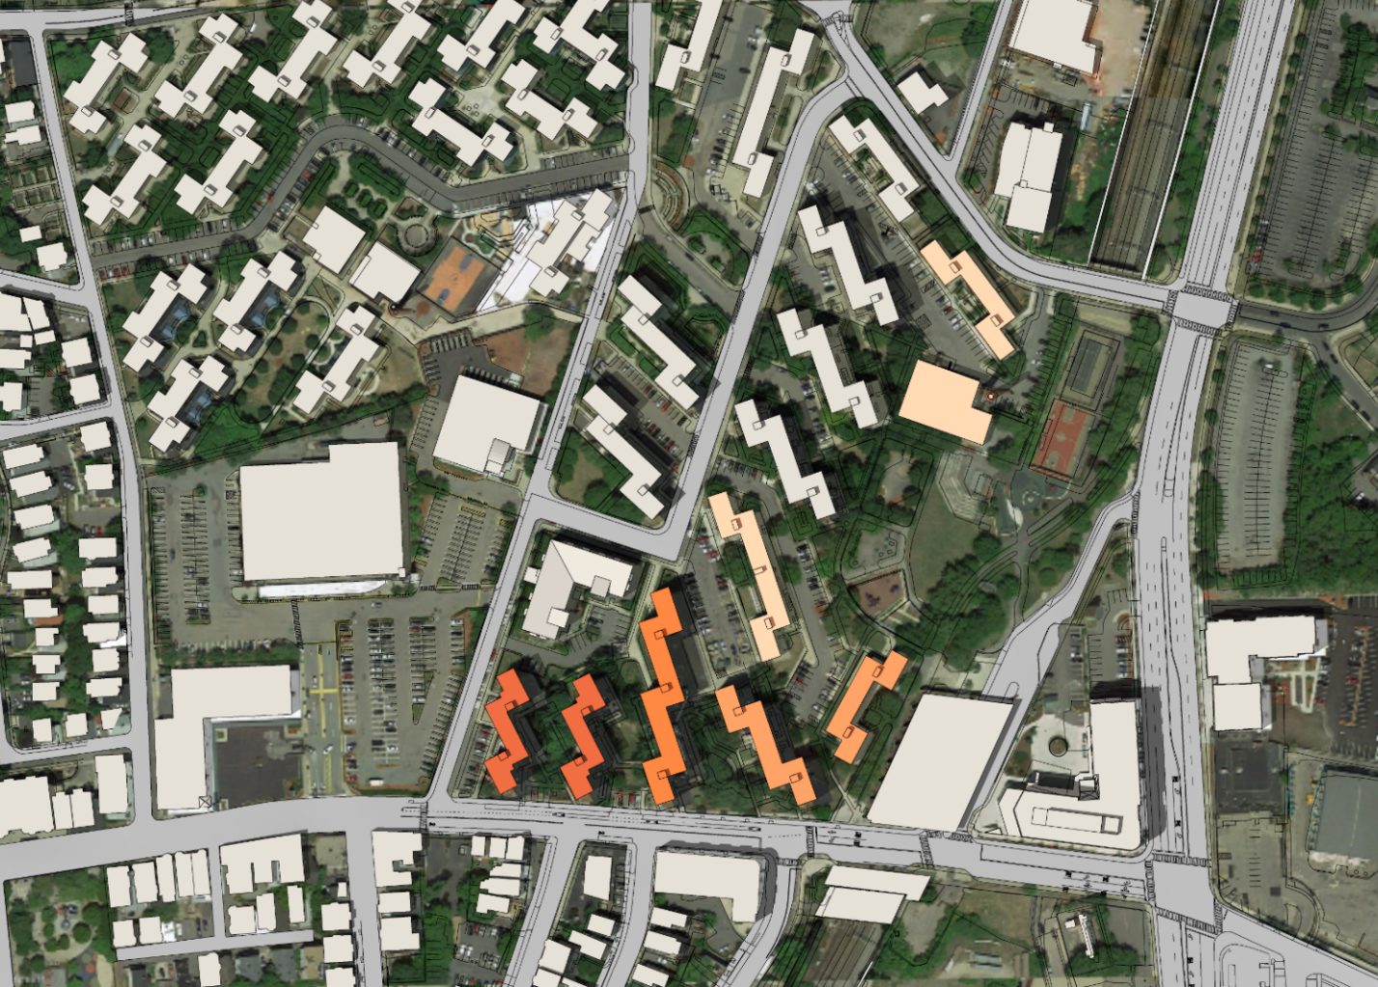
Pre-redevelopment Site Plan
24 + 34 Heath St
Anna Mae Cole Center
960, 962, 964
Parker St
50 + 52 Lamartine St
265 + 267 Centre St
295 + 297 Centre St
285 + 287
Centre St
275, 277, 279 Centre St
Notes:
Laura
- Note that the site is a portion of the MH site
- Note that which buildings are in the redevelopment area will be in this slide deck, posted to the BPDA website, and on the projects web-page, so that people can refer back to this list

Slide 5
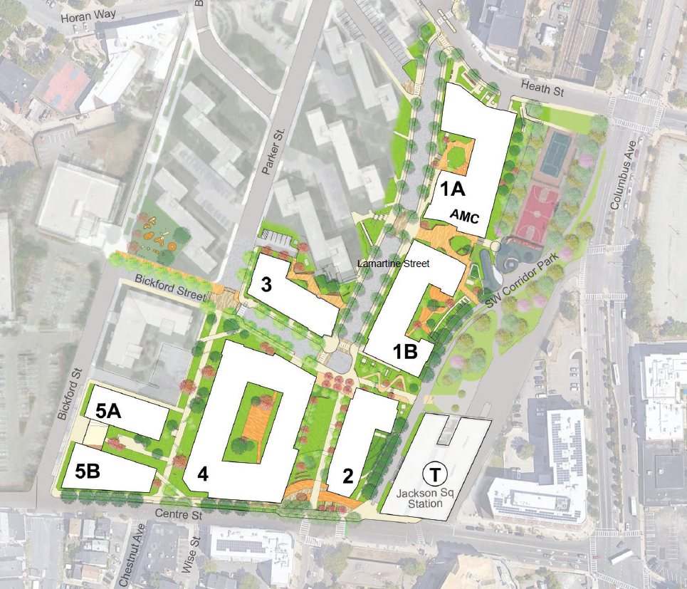
Post-redevelopment Site Plan
STREET
LAMARTINE
Notes:
Laura
7 new buildings

Slide 6
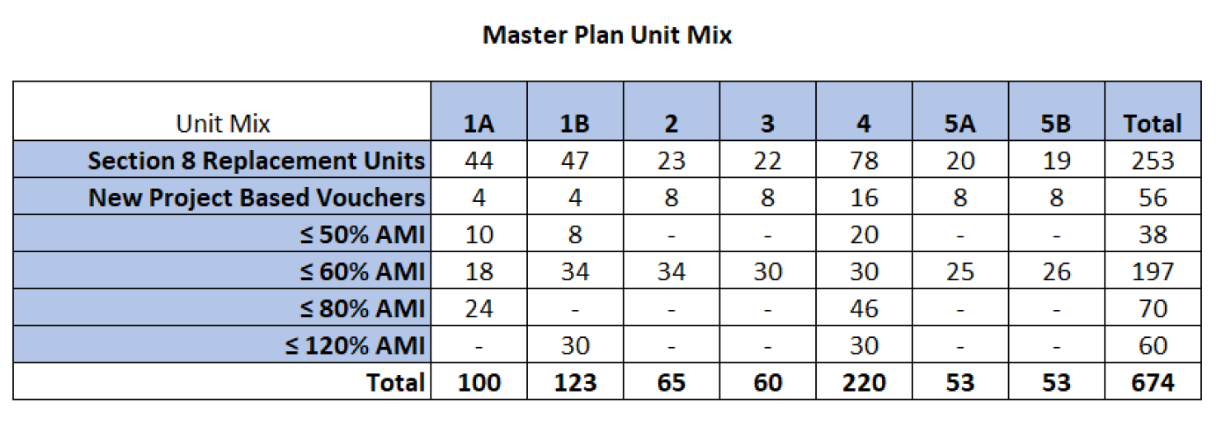
Master Plan Proposed Unit Mix
STREET
LAMARTINE

Slide 7
Phase Two Relocation Overview and Schedule
Who needs to move?
Families who live in 265 and 267 Centre Street and 50 and 52 Lamartine Street
When do I need to move?
Families will need to move by end of 2025
What are my relocation options?
Direct move to the new the new buildings at 2 and 6 Lamartine STreet
Move to another BHA public housing community, if available, public housing units within MCH
Down payment assistance toward the purchase of a home
Who will help me with my relocation?
Judy Cohn Housing and Relocation Consultants is the on-site Relocation Services Provider
Kyrah Rodriguez
Jason
On-site address:
Phone: 445-2225 ext 1
STREET
LAMARTINE

Slide 8
Phase Two Relocation Counseling Services
Relocation staff will provide relocation counseling assistance to all Phase Two households
Relocation staff will meet with each household to discuss the relocation options and benefits of each
Each household will let the Relocation staff know their relocation preference
All moving expenses will be covered by BHA/development team
STREET
LAMARTINE
Notes:
Judy and Kyrah

Slide 9
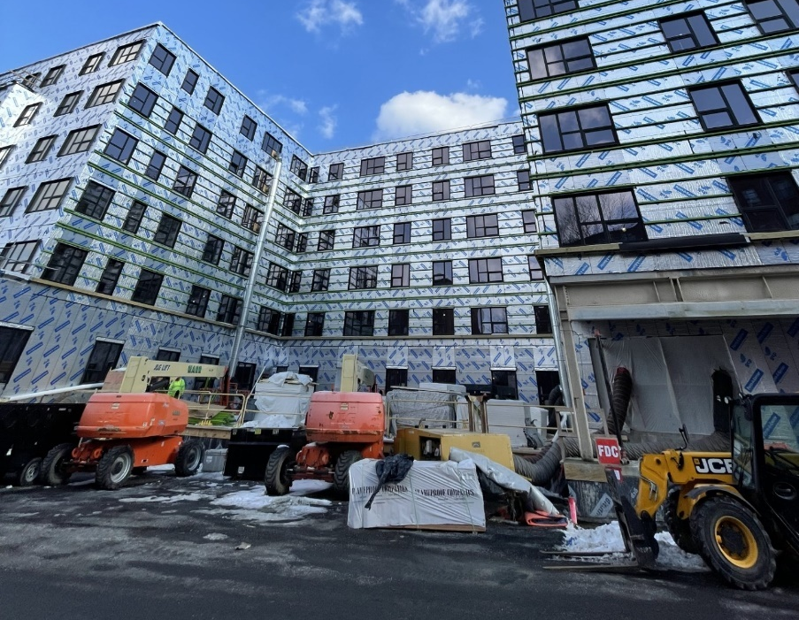
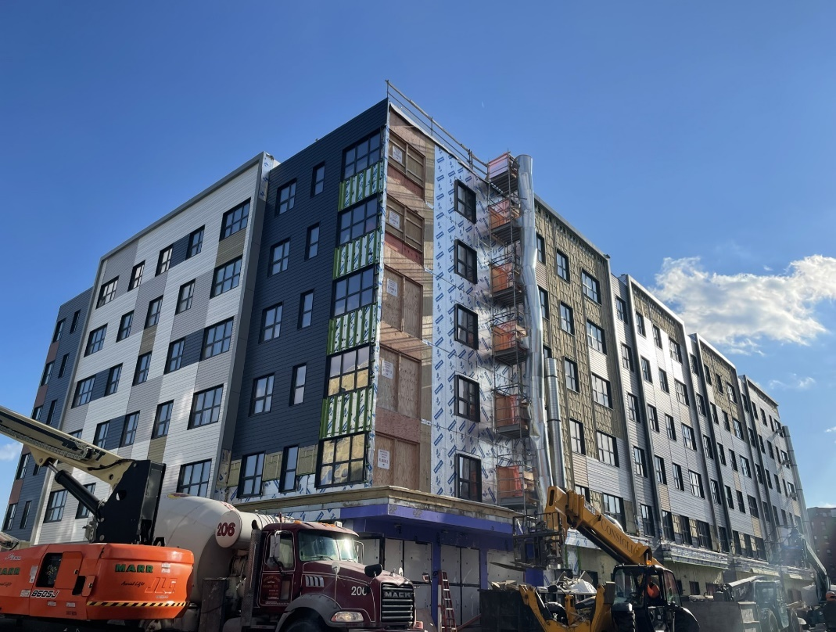
Construction Progress
STREET
LAMARTINE
2 Lamartine Street
6 Lamartine Street
Notes:
7 new buildings

Slide 10
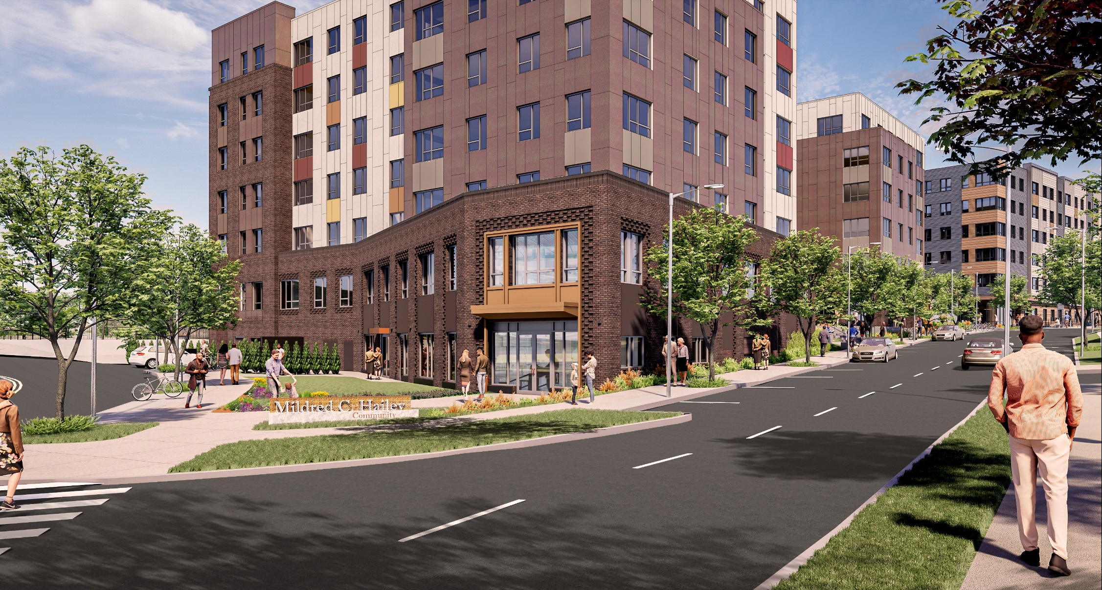
View from Heath Street
Notes:
- Corner community space to active the streetscape

Slide 11
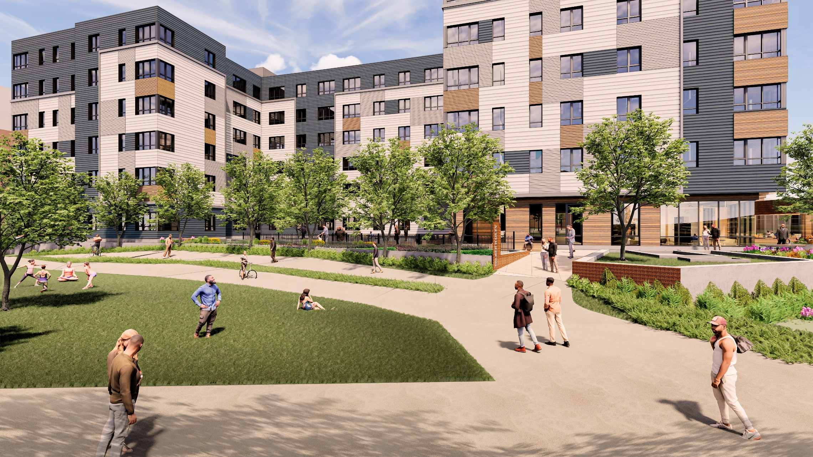
View from Southwest Corridor of 6 Lamartine

Slide 12
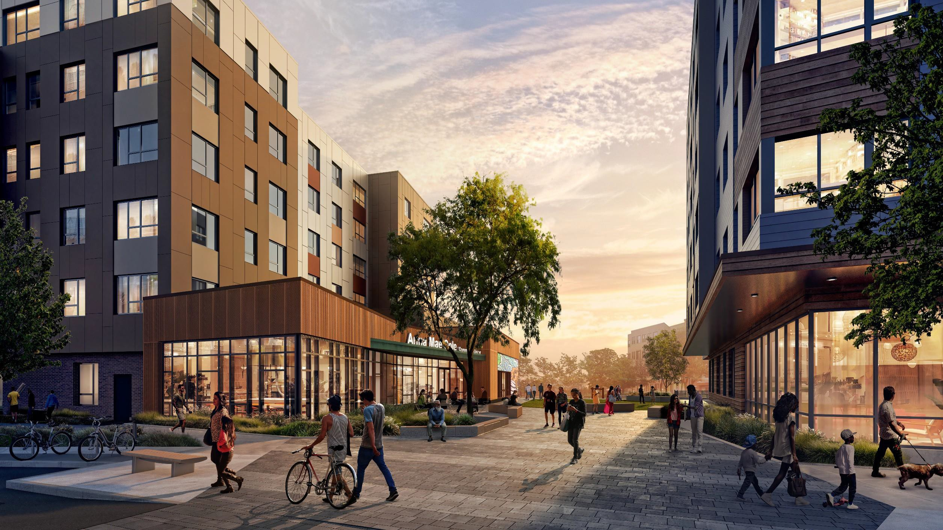
Community Plaza (View looking towards SW Corridor)

Slide 13
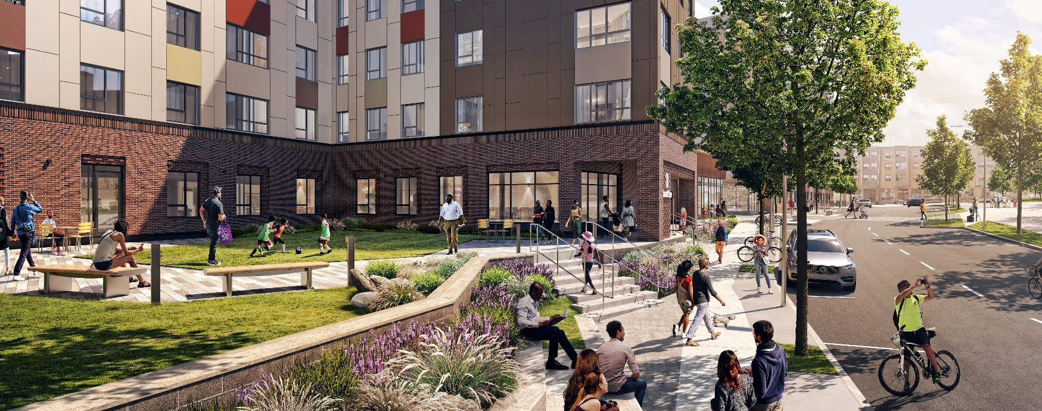
2 Lamartine Courtyard
D

Slide 14
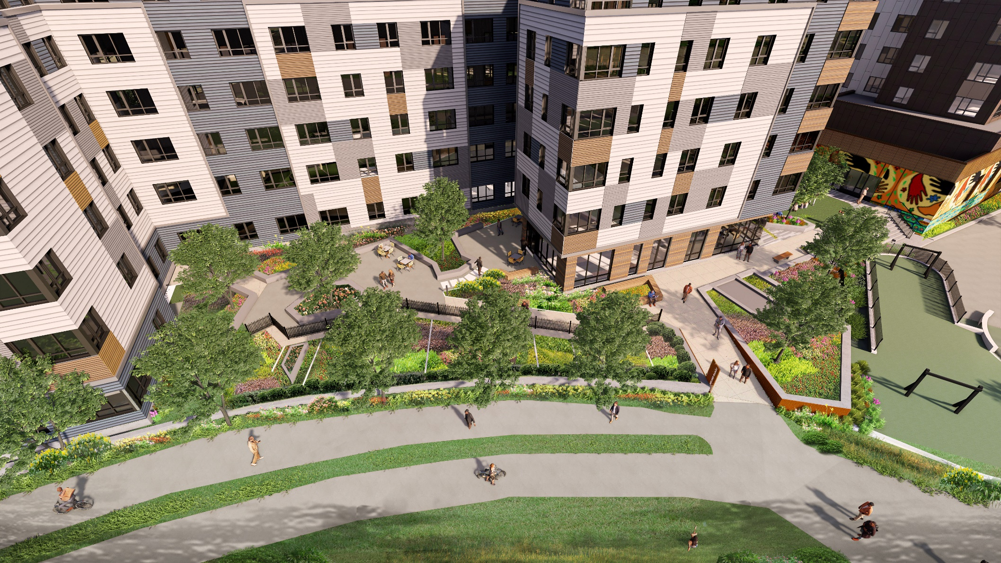
6 Lamartine Courtyard (Aerial view)
D

Slide 15
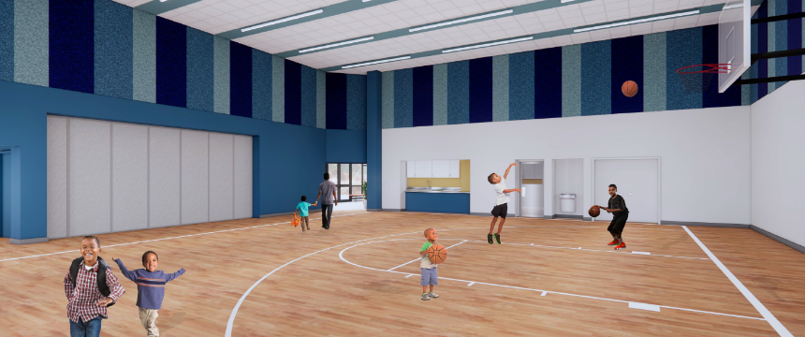

New Anna Mae Cole Community Center

Slide 16
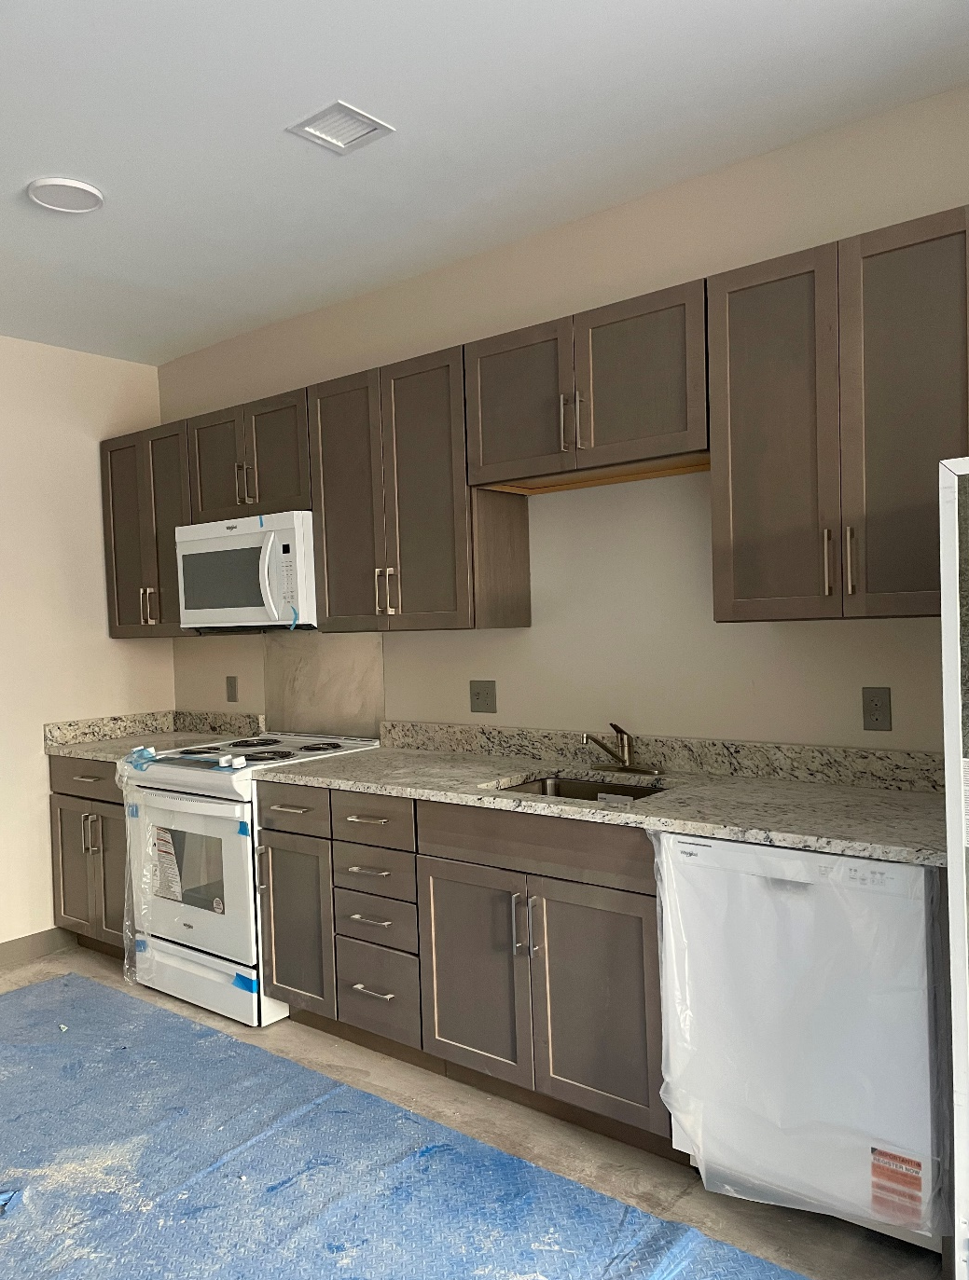
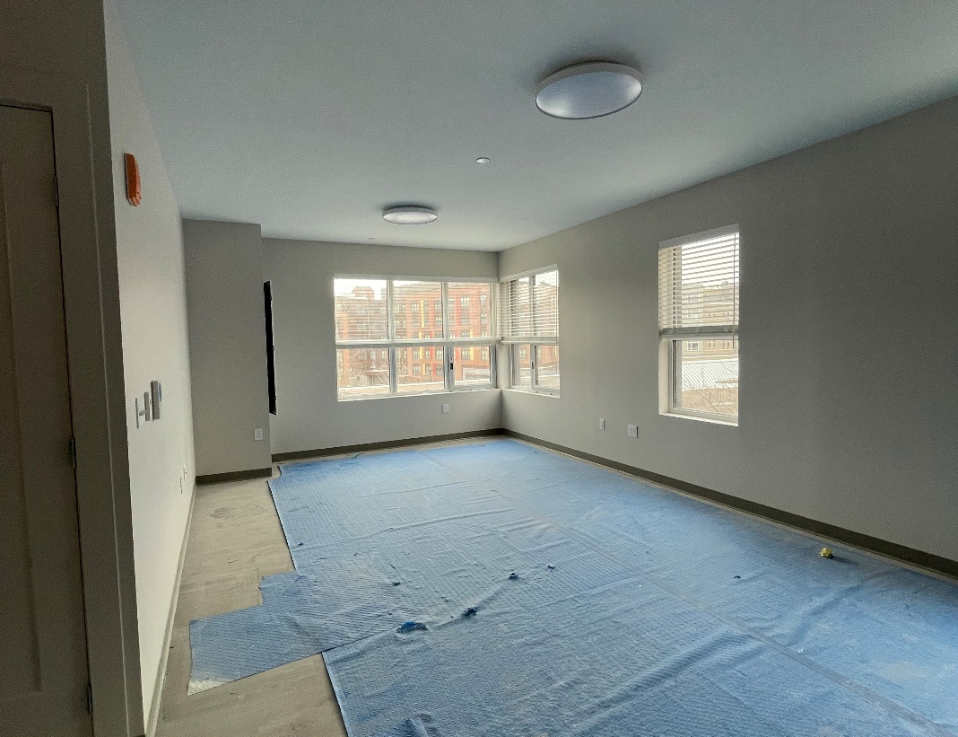
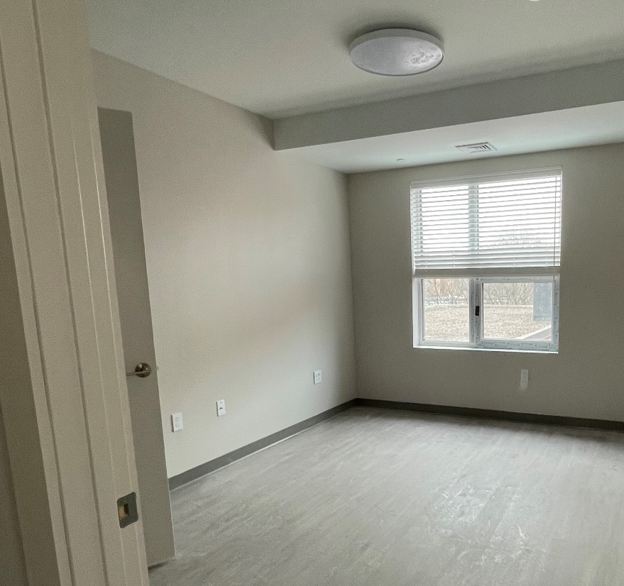
2 and 6 Lamartine Street: Unit and Building Features
Energy-efficient appliances (dishwasher, stove, refrigerator and microwave)
Enhanced security system (including keyless entry and intercom system)
Each unit equipped with thermostat, allowing you to regulate your heat
Central air-conditioning
Laundry suite on each floor
Trash and recycling room on each floor
Building paid utilities
Notes:
Fully accessible units for households who need handicap or hearing impairment features

Slide 17
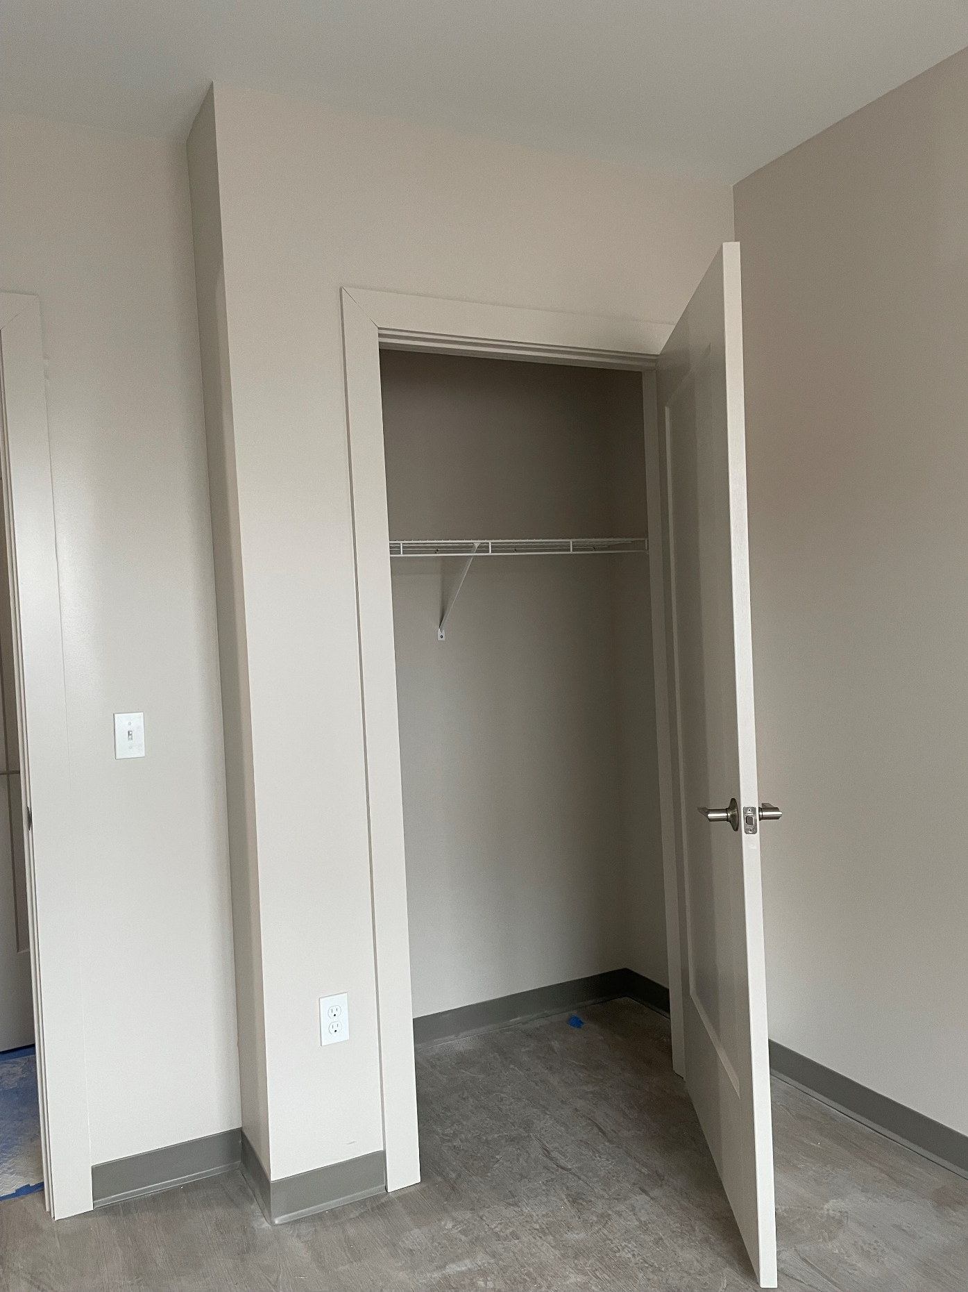
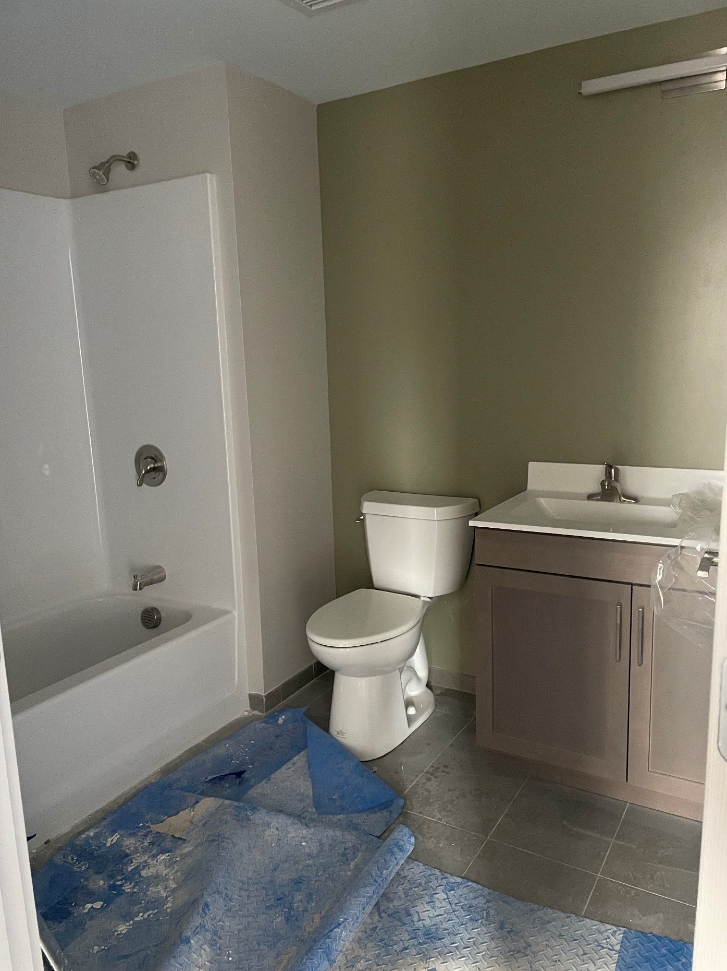

Slide 18
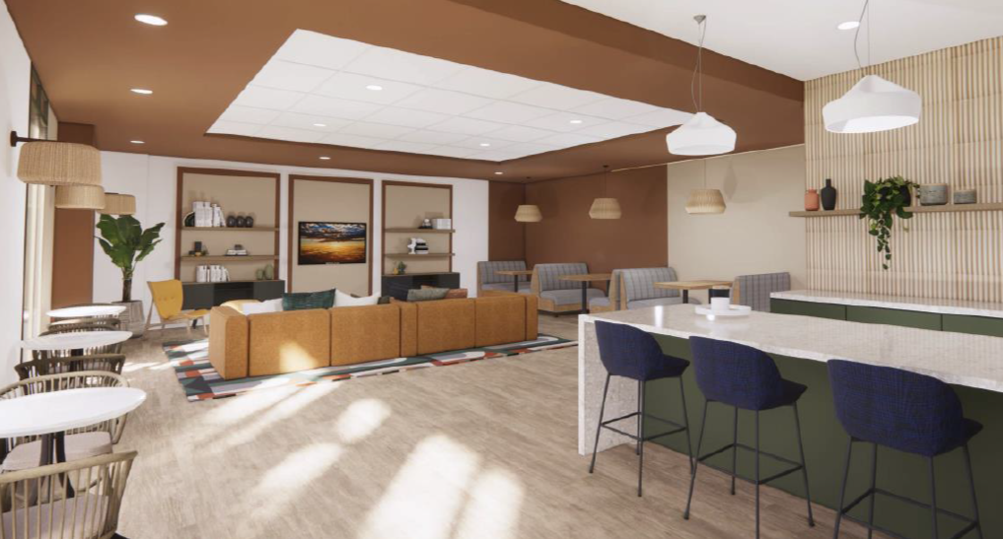
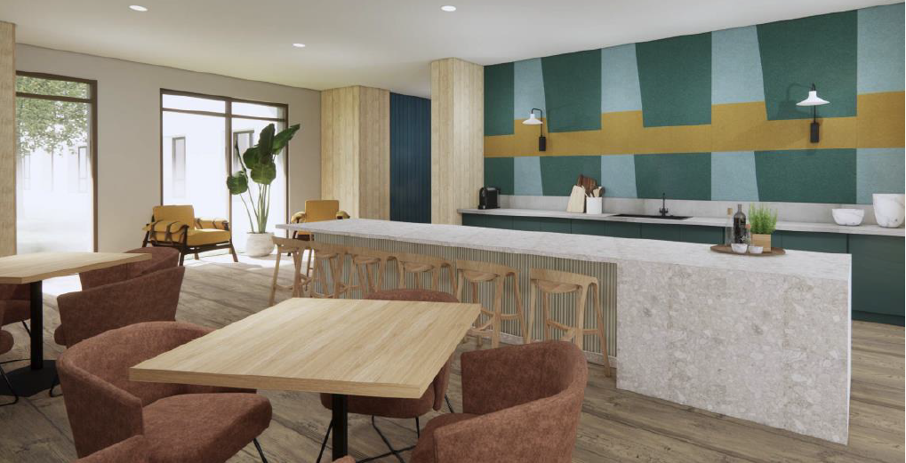
2 and 6 Lamartine Street: Amenities
Innovation Center with access to computers and printer/scanner
Spacious lobbies and resident lounges on the first floor
Resident courtyards with a community garden
Close proximity to the new Anna Mae Cole Community Center
Underground parking garage and indoor bike parking
Notes:
Existing residents who currently have parking stickers at the site and live in the redevelopment area will be eligible to receive garage parking spaces at no charge (Note that there will be limited parking spaces for new residents)

Slide 19
2 and 6 Lamartine Street Lease Up Process
Confirm household composition and pets– any proposed new household members should be processed with BHA management before April 30, 2025.
TCB Management and BHA will notify household of screening appointment.
All adult household members must attend an appointment and provide photo ID, Social Security Cards, Birth Certificate, income, asset information for all household members and if applicable, proof of pet registration (if have pet).
TCB will determine eligibility for LIHTC program and BHA Admissions Department will determine eligibility for Section 8 Project Based Voucher (PBV) program and the amount you will pay for rent.
Household will be assigned a unit based upon bedroom size need, unit feature and any approved reasonable accommodations in accordance with the priority categories.
Households will not be re-screened except for income/program eligibility for the LIHTC and Section 8 PBV programs. The Section 8 PBV program requires all returning households with rent balances to either clear their rent balances or enter into a repayment agreement with BHA Leased Housing prior to Section 8 PBV approval.
Notes:
TCB Management and BHA

Slide 20
2 and 6 Lamartine Street Lease Up Process
Unit offer— Once approved for LIHTC and Section 8 PBV programs, household will receive a formal unit offer in writing from TCB Management.
Unit viewing—household views the unit and makes decision to accept or refuse the unit (5 business days). The household will only receive one unit offer unless there is good cause for a refusal.
Move scheduled—once household accepts unit, Relocation staff schedules move with licensed moving company.
30-Day Notice—Relocation staff will assist household to provide 30-Day Notice to Vacate to current landlord (BHA or private landlord)
Pest Inspection—resident’s current unit is inspected to ensure there are no pests; treatment scheduled, if needed.
Packing Supplies—Relocation staff arranges for household to receive packing supplies
School Transfer—Relocation staff works with resident and BPS if need school/s transfer
Notes:
Kyrah

Slide 21
2 and 6 Lamartine Street Lease Up Process (cont.)
Change of Address—JCHRC assists household with USPS change of address
Lease Signing and Key Pick up—Resident signs lease and obtains keys for new unit (day of move-in)
BHA Move out process – Sign surrender and release and return keys
Move Day—Moving company moves all household belongings to new unit
Telecommunication Re-connection Fee Reimbursement—Resident brings first phone/cable/Internet bill for new unit to be reimbursed
New Move-in Orientation—TCB, Task Force, Leased Housing and JCHRC conduct mandatory information session that covers new lease and unit amenities
Notes:
Kyrah and Keveisha

Slide 22





Screening Letter
TCB will send a appointment
letter to Phase Two households. The letter will include a list of documents to bring to the appointment.
Mildred C. Hailey Lease Up
Process for 2 and 6 Lamartine Street
Prepare to Move
1) Households must register their pets with BHA and TCB Management prior to move in
2) 30-Day Notice sent to current Landlord by Household
3) Pest Inspection
Moving In; Lease Signing
1) Move Scheduled (Including Packing Assistance if Needed)
2) Relocation staff provides Packing Supplies
3) Transfer Utilities & Change of Address
4) Sign Lease and Key Pick Up
5) Move Occurs
6) Move-in Orientation
7) Cable/Internet reconnection fee, other resident moving expenses reimbursed by Relocation staff. Itemized bills or receipts must be submitted.
Household Income, Assets, etc. Reviewed
During the appointment, TCB and Relocation staff will collect the paperwork for Section 8 PBV and LIHTC eligibility.
Households with rent balances must either clear their rent balances or enter into a repayment agreements with BHA Leased Housing in order to meet Section 8 PBV eligibility. TCB and Relocation staff will assist households with appropriate referrals.
ACCEPT
Unit Viewing
Relocation staff and TCB Management will accompany you to view your assigned unit.
5 days to accept or decline
You’re settled in your brand-new MCH unit.
Households will be asked to confirm in writing that they are not interested in returning to a redeveloped unit at MCH, waiving their Right to Return.
DECLINE
WELCOME HOME
Thank you for your patience during the relocation and renovation process.
Notes:
Amy

Slide 23
Next Steps
Relocation staff is starting to reach out to all MCH Phase Two families to collect conduct relocation survey and prepare families for relocation
Deadline to add new household members to lease by April 30, 2025.
Starting in April/May appointment letters from TCB Management and BHA will be mailed to MCH families
Attend scheduled appointment with TCB and Relocation staff
Bring required screening documents for all household members
Communicate regularly with TCB and Relocation staff throughout the lease up process
Units ready for viewing in summer 2025
Building will be ready for occupancy mid June 2025

Slide 24
WHAT TO EXPECT AFTER MOVE-IN
Going forward you will have to complete two annual recertifications. One will TCB Management for the tax credit program, and one with the Boston Housing Authority for the Section 8 program.
You will be assigned a BHA Housing Specialist who process your annual recertification and can assist you will the following:
      Rent Adjustments
      Addition To The Lease
      Reasonable Accommodation Requests
Notes:
Amy

Slide 25
QUESTIONS & DISCUSSION

