Slide 1
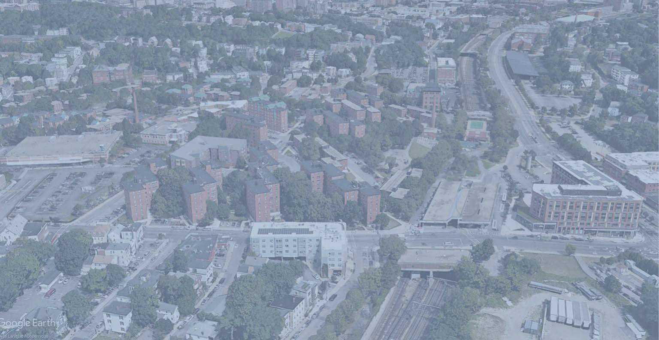



Mildred C. Hailey Construction Update
1

Slide 2

Meeting Ground Rules
This is a hybrid meeting, which means we have attendees on Zoom and in person
Zoom chats will go directly to the Zoom Host
Interpreters in-person and on zoom
During Q&A, please use the “raise hand” function and
the host will unmute you to ask your question
o 2-3 minutes per question/comment

Slide 3
Agenda
Meet the Team!
2 and 6 Lamartine Street Residential Building Information
Demolition and Construction Overview
How to Stay Informed about Mildred C. Hailey Apartments Development and
Construction Updates
Programming During Construction
Modernization
Q&A Session

Slide 4
The Boston Housing Authority Team
Mildred C. Hailey Tenant Organization
Boston Housing Authority
  Administration
  Operations and Property Management
  Planning, Development, Capital Construction
  Language Access

Slide 5


Centre Street Partners Team

Slide 6

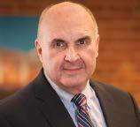
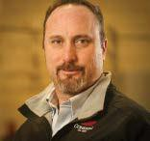
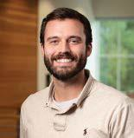
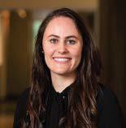
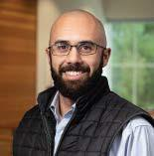
Consigli Construction Team
Ryan Jennette
Director of Operations/Boston
– Project Executive
Christopher Scarvalas
Pre-construction Director
John Laperle
General Superintendent
Kyle Raposo
Project Superintendent
Kevin Samya
M/E/P Manager
Melissa Sue Guertin
Project Manager

Slide 8
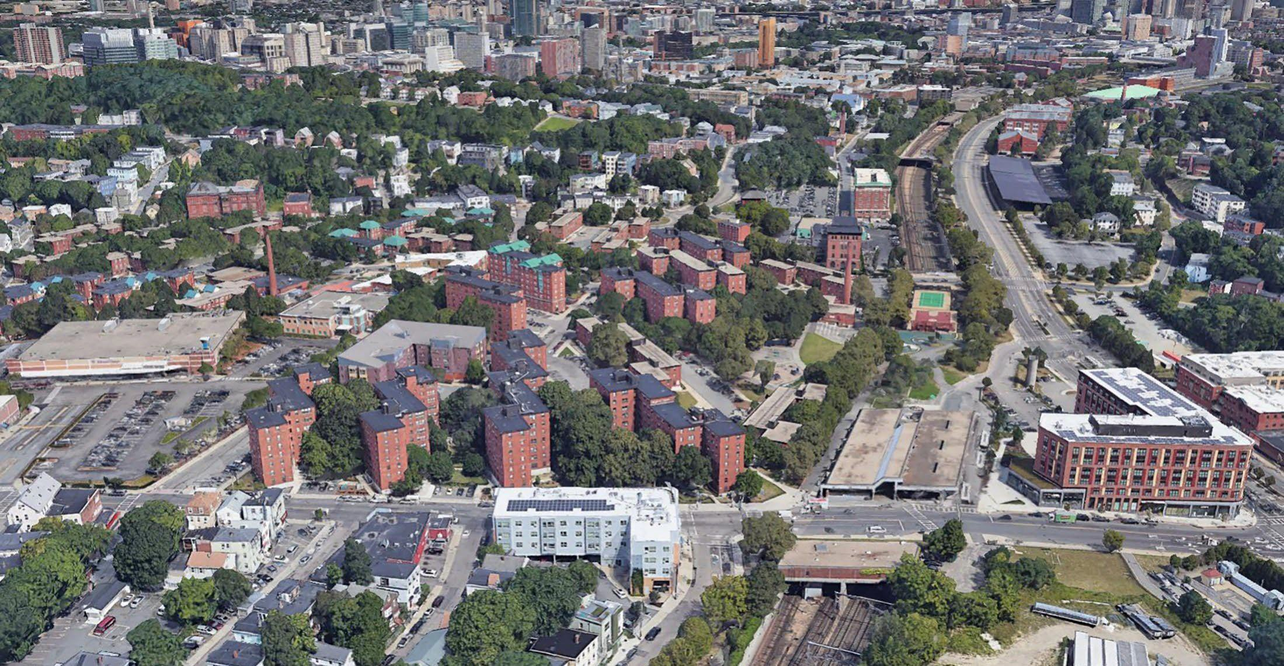



Master Plan Site Area
Larger Mildred Hailey housing development area
Centre Street Partners development site
Stop and Shop
T
Jackson Sq MBTA
Station
CENTRE STREET
2

Slide 9
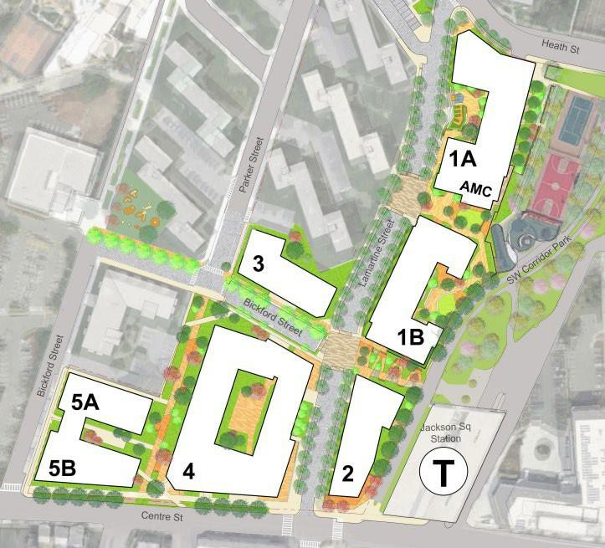







2 and 6 Lamartine Street Site Map and Program
1:1 replacement of original units; 223 income-restricted units total
98 spaces in a partially underground garage
New open space throughout
the Mildred C. Hailey campus
6,800 sf community center
1,500 sf community space/ neighborhood retail
4

Slide 10
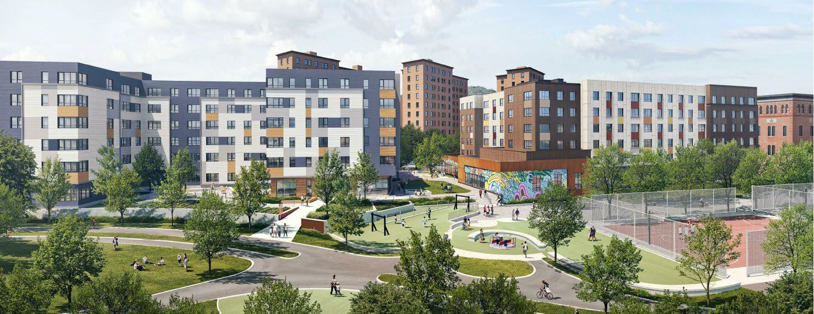
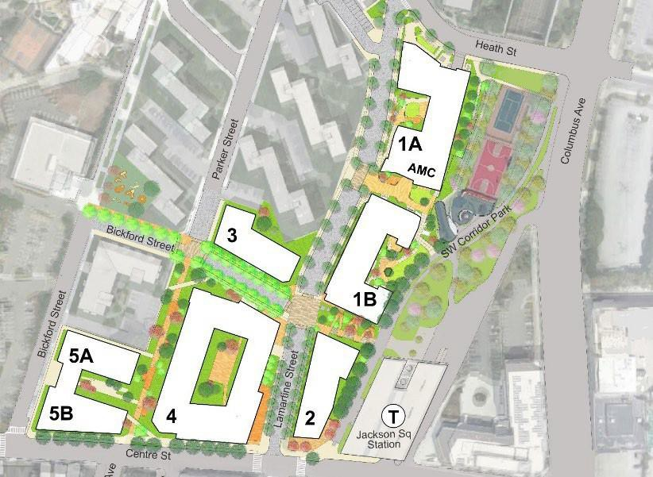
Buildings 2 and 6 Lamartine Street:
View from Columbus Avenue
7

Slide 11
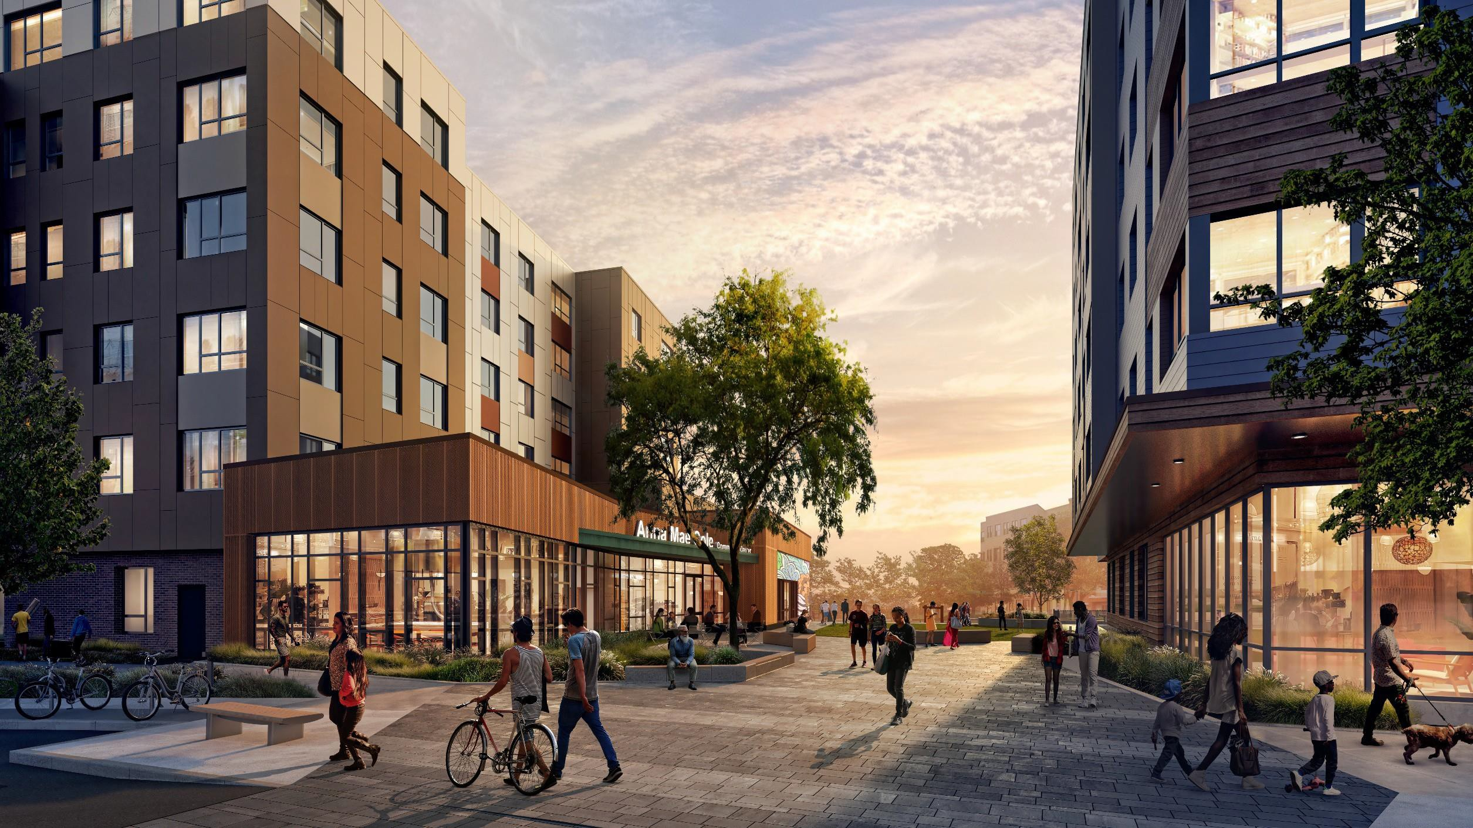
View of New Community Plaza
Buildings 2 and 6 Lamartine Street:

Slide 12
How many construction workers will be onsite on a given day?
Demolition & Construction: Daily Expectations
What’s the plan for noise & odor control during construction?
Construction Hours:
7:00AM – 6:00PM
Monday through Saturdays

Slide 13
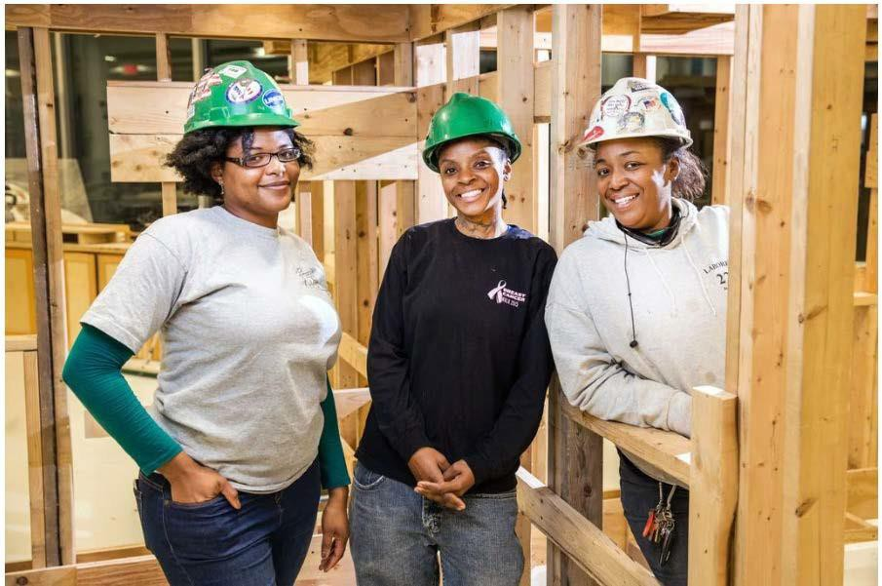
Resident Job Opportunities
What opportunities are
available?
Where can you pick up and submit the job application?
  The BHA Management Office located at 30 Bickford St.
  In the two drop boxes by gate to the construction site
    One unlocked drop box will contain blank applications
    One locked drop box is where you can submit your application

Slide 14
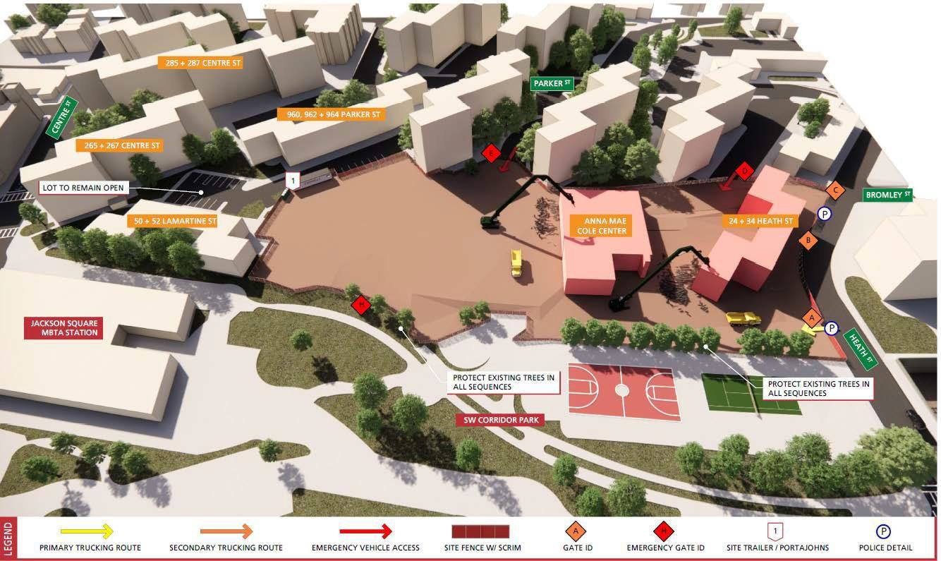
Construction Logistics: Demolition
ANNA MAE COLE CENTER
24 + 34 HEATH ST

Slide 15
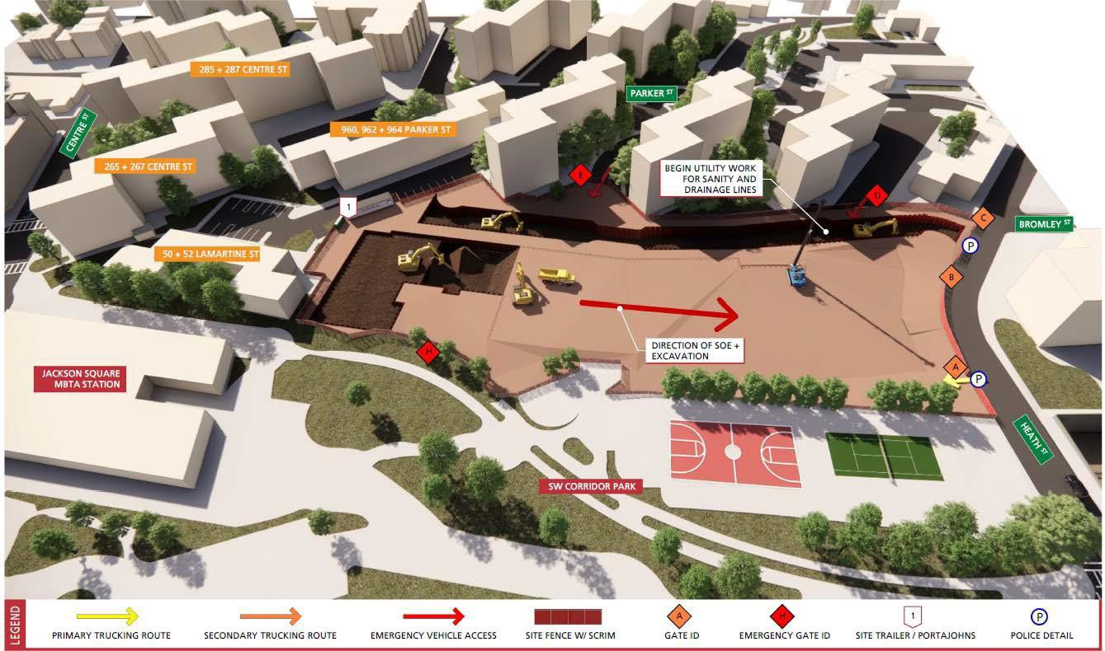
Construction Logistics: Excavation
BEGIN UTILITY WORK FOR SANITARY AND DRAINAGE LINES
DIRECTION OF
EXCAVATION

Slide 16
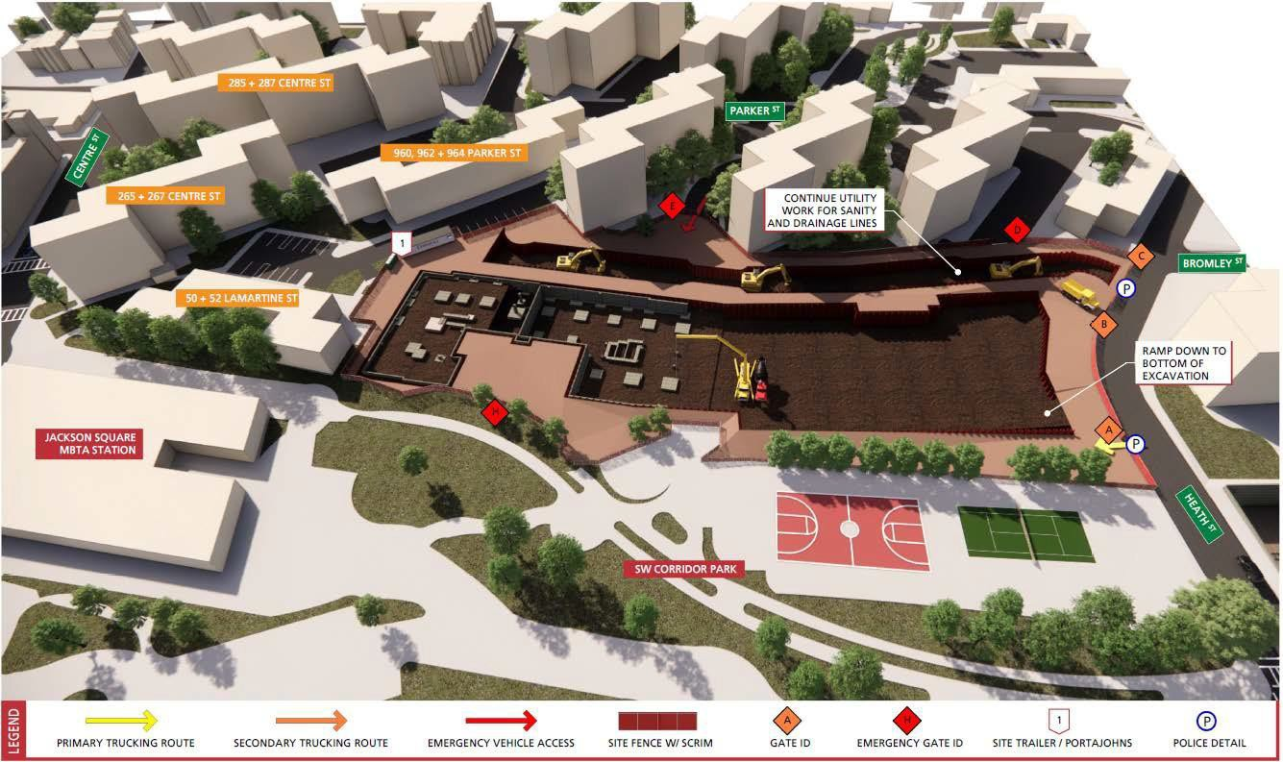
Construction Logistics: Foundations
BEGIN UTILITY WORK FOR SANITARY AND DRAINAGE LINES

Slide 17
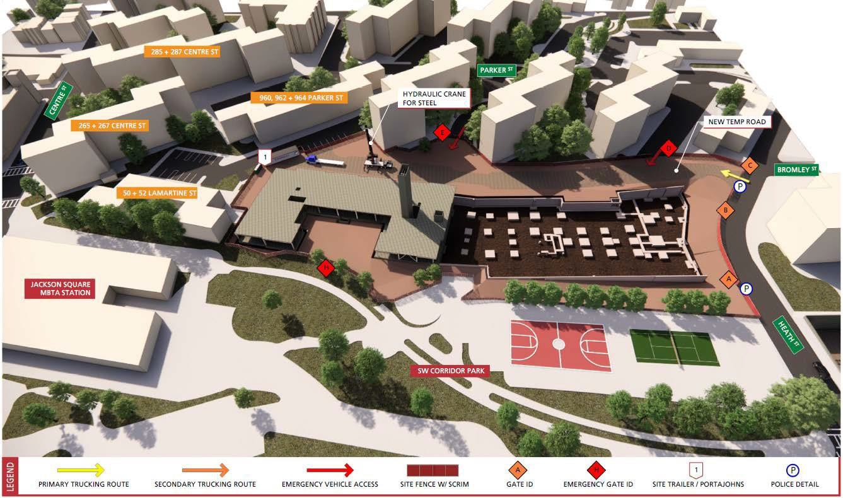
Construction Logistics: Structural Steel

Slide 18
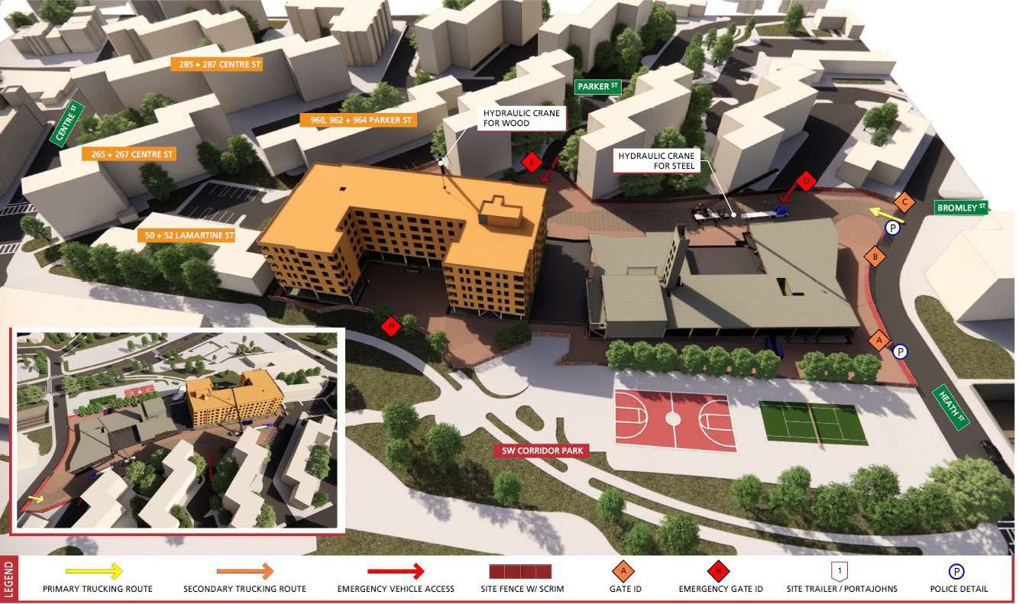
Construction Logistics: Wood Framing

Slide 19
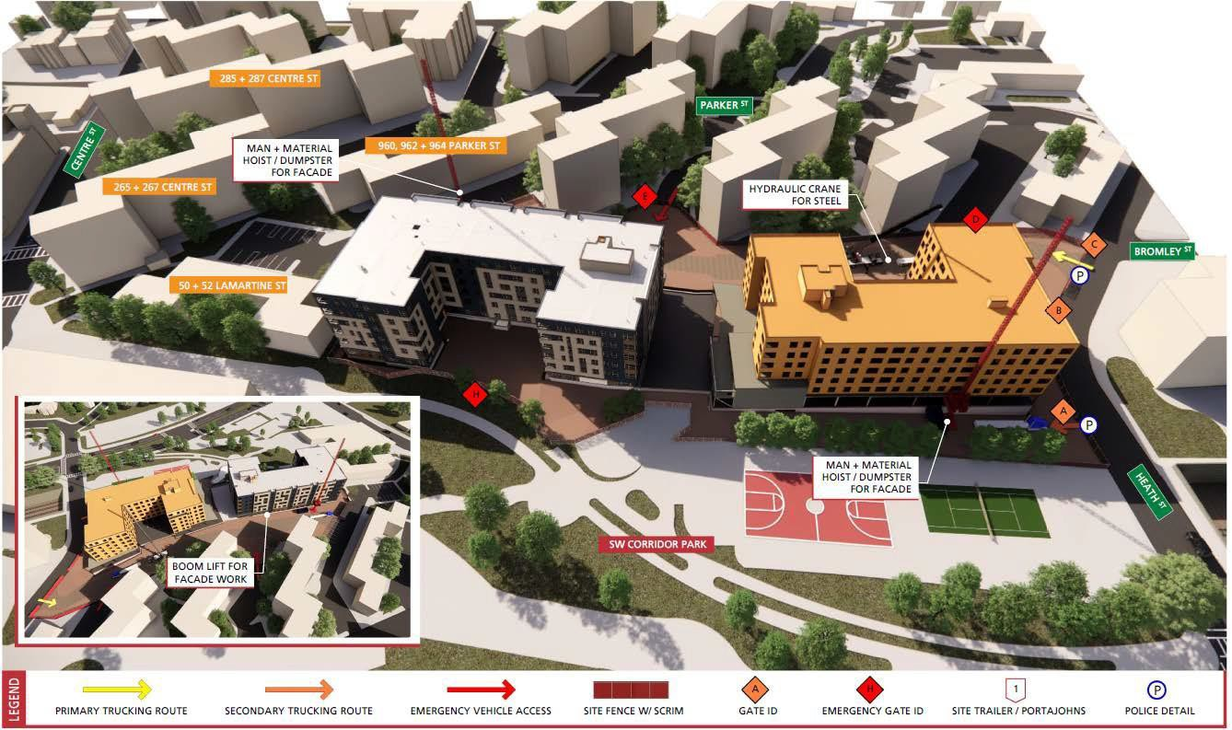
Construction Logistics: Façade + Fit Out

Slide 20
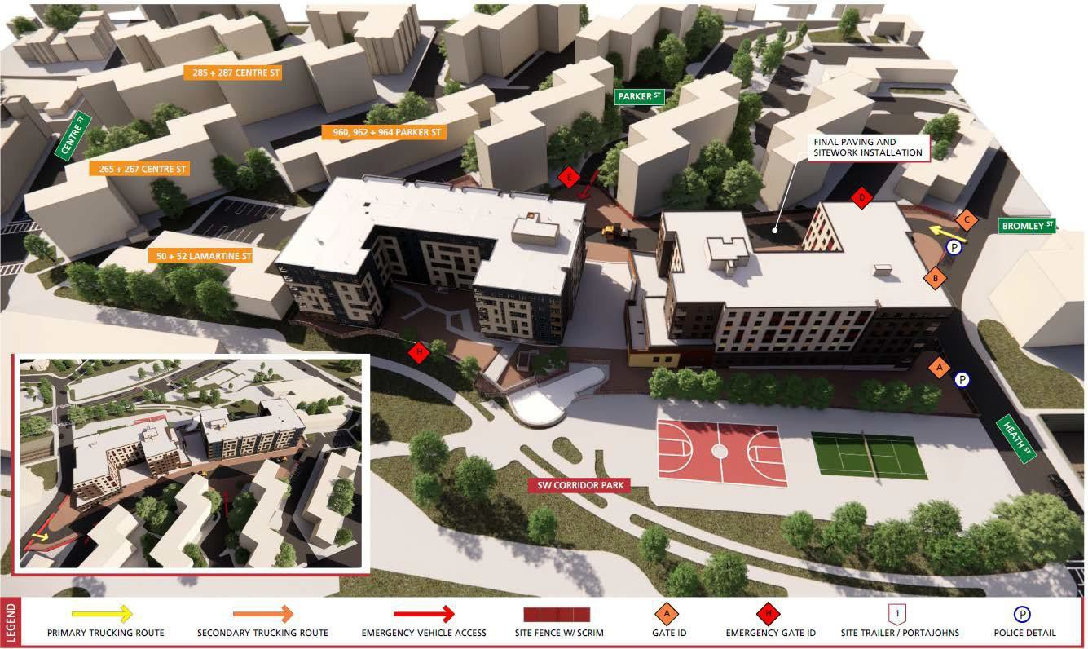
Construction Logistics: Landscaping

Slide 21
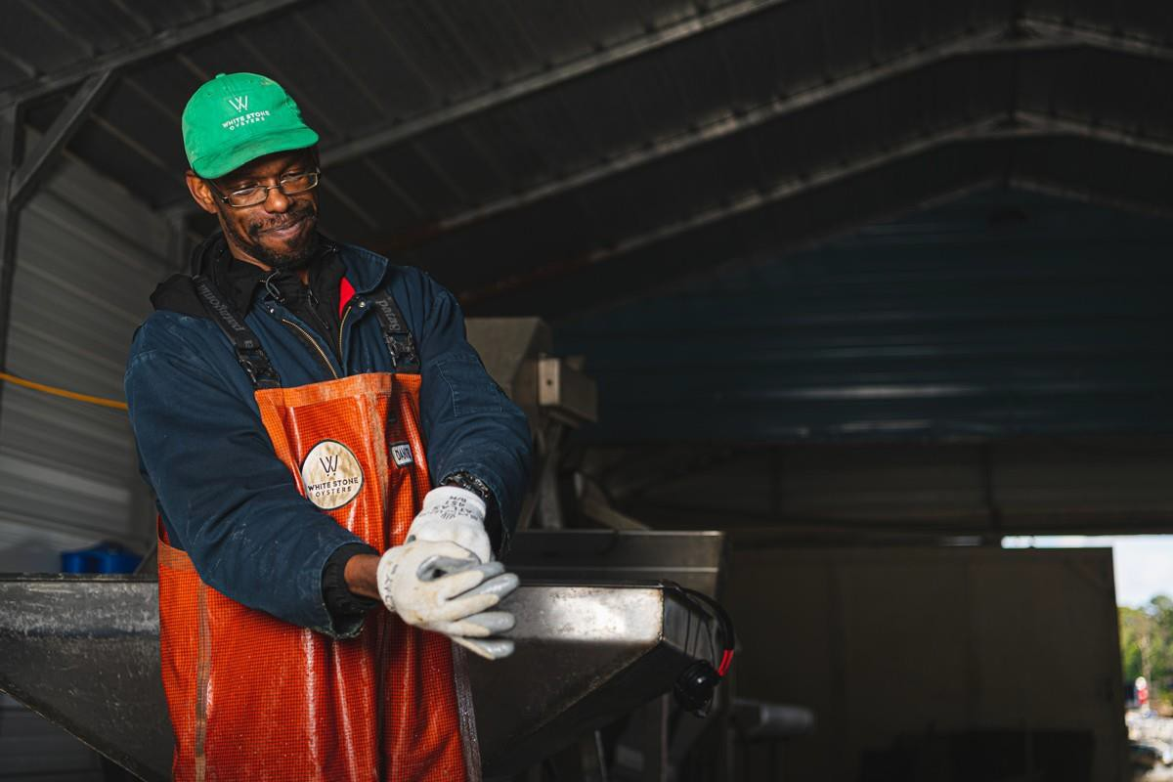
Safety and Security During Demolition and Construction
Protection from (airborne) hazardous materials
- Dust Control
Blocking off access to the two
vacant buildings
Rodent Control

Slide 22
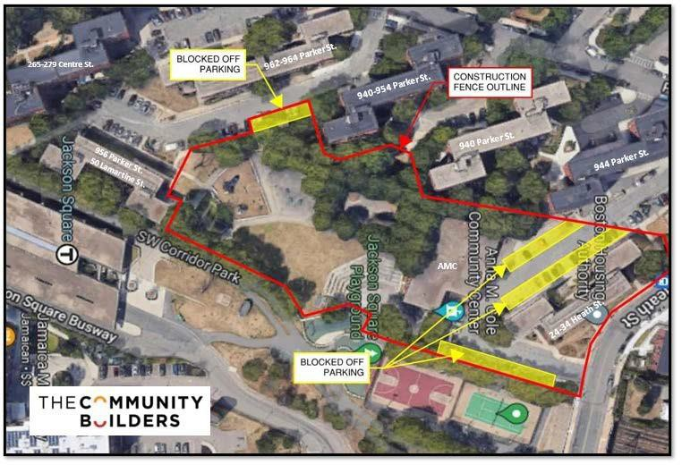
Construction Site Fence Area, Parking, and Pedestrian Detours

Slide 23
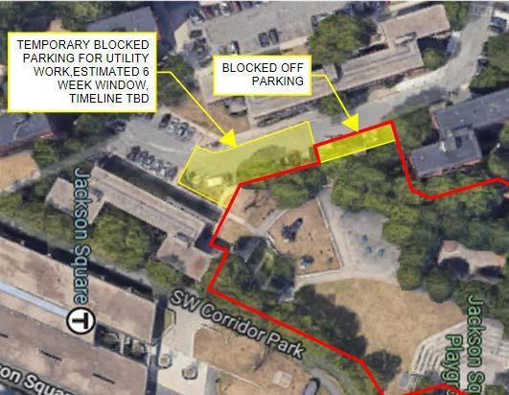



Temporary Blocked off Parking Adjacent to 50 Lamartine St.

Slide 24
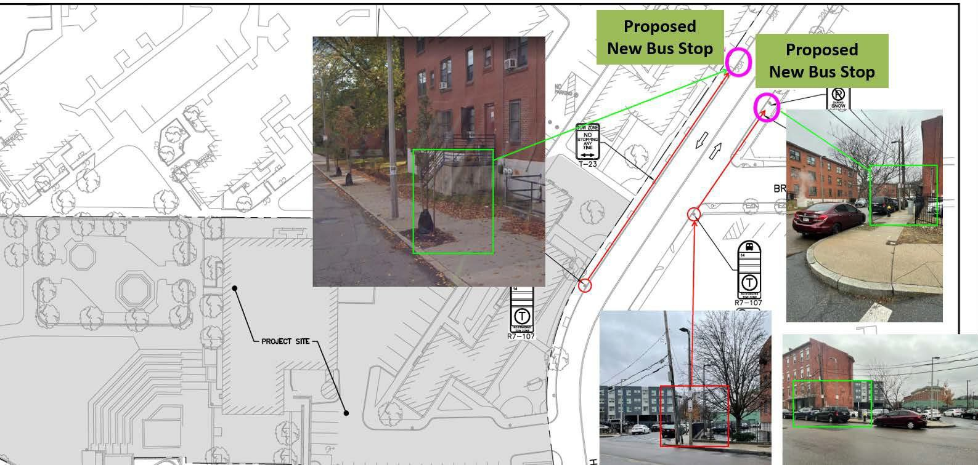
Temporary Bus Stop Relocation
Existing
Bus Stop
Existing Bus Stop

Slide 25
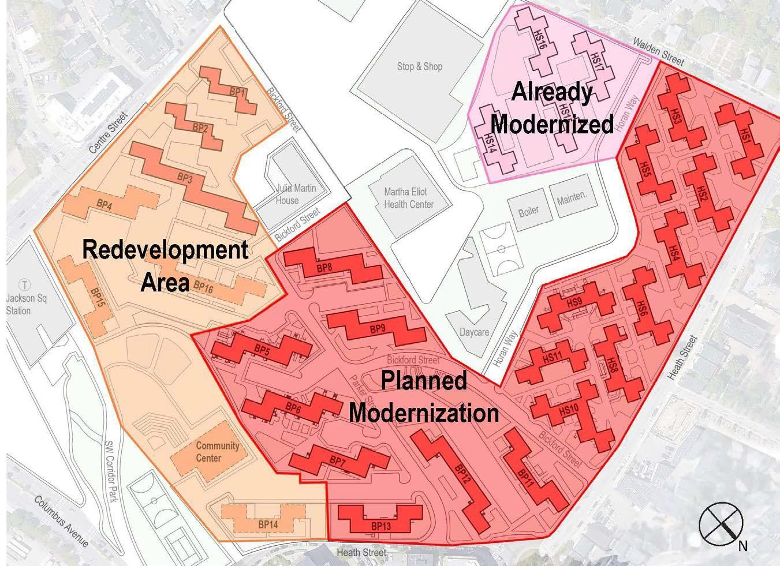
Modernization
Apartments
Abatement ofhazards Accessibility upgrades New bathrooms New kitchens New plumbing New ventilation systems New heating and cooling systems New windows and doors New paint Connections for washers and dryers where space allows
Buildings and Site
New roofing New elevators Fire alarm and life safety upgrades Electrical upgrades Site utility upgrades Landscaping enhancements

Slide 26

How to Stay Informed about Mildred C. Hailey Development and Construction Updates
BHA Newsletters
Talk with MCHTO representatives, get
involved with MCHTO
Future Resident Meetings
Email info@haileyapartments.com
Visit http://haileyapartments.com or scan
the QR code to the right
Contact the BHA senior project manager Carolyn Barry at (617) 988-4128

Slide 27


Partners and Programming During Construction

Slide 28
Partners and Programming During Construction
FOOD DISTRIBUTIONS
  BHA, Boston Children’s Hospital, MCHTO - 30 Bickford Street
  Tree of Life - 297 Centre Street
  964 Collaborative - 964 Parker Street
CHILDREN UNDER 5
  Tree of Life – 297 Centre Street, play groups and Welcome Baby
  Smart from the Start – 31 Heath Street @ The Possible Zone, play group and Family Fun Night
YOUTH PROGRAMMING
  BHA Youth Center - 30 Bickford Street
  The Possible Zone, 31 Heath Street, high school students
  Homework Help, 30 Bickford Street
ADULTS
  MCHTO - Zumba Classes
  964 Collaborative – 964 Parker Street, Men’s Clothing
  Tree of Life – 297 Centre Street, Mother’s Group
  Living Safely in Jackson Square - Community Action/Leadership
  Tech Goes Home – 30 Bickford Street, Computer Classes

Slide 29
THANK YOU!
Q&A
Questions about planned work? Or to share suggestions or concerns,
Please contact the BHA senior project manager Carolyn Barry at (617) 988-4128.

